Slide 1
High Performance Computing with R (Session 2)
Jason Hou-Liu
Department of Statistics and Actuarial Science, University of Waterloo

Slide 2
What is C++?

Slide 3
What is C++
C++ is:
A compiled language
Harder to write
Slower to prototype
Surprisingly easy to integrate with R
Can be very fast

Slide 4
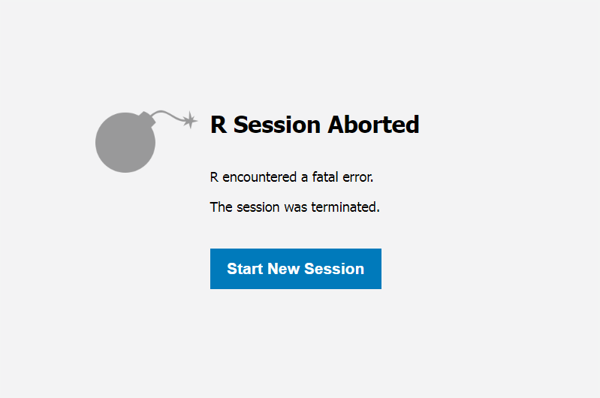

Why C++
C++ is actually a great pairing with R
Prototype first in R
Translate to C++
Mix-and-match functions
Using C++ can be annoying

Slide 5
Why (not) C++
using C++ compiler: 'G__~1.EXE (GCC) 12.2.0'
using C++11
g++ -std=gnu++11 -I"C:/Program Files/R/R-43~1.0/include" -DNDEBUG -I../inst/include -fopenmp -I"C:/Program Files/R/R-43~1.0/library/Rcpp/include" -I"C:/Program Files/R/R-43~1.0/library/RCPPAR~1/include" -I"T:/Temp/RtmpU1Ie8D/sourceCpp-x86_64-w64-mingw32-1.0.10" -I"C:/rtools43/x86_64-w64-mingw32.static.posix/include" -O2 -Wall -O3 -march=native -mtune=native -pipe -mno-rtm -mno-fma -flto -ffat-lto-objects -fuse-linker-plugin -flto -ffat-lto-objects -fuse-linker-plugin -c file160c23a66f78.cpp -o file160c23a66f78.o
file160c23a66f78.cpp: In function 'arma::mat m_step_cpp(const arma::mat&, const arma::mat&, Rcpp::List)':
file160c23a66f78.cpp:60:44: error: expected ')' before ';' token
60 | sigma[g] = weighted_cov(data, wt, mu[g];
| ~ ^
| )
In file included from C:/Program Files/R/R-43~1.0/library/RCPPAR~1/include/armadillo_bits/Mat_meat.hpp:9997,
from C:/Program Files/R/R-43~1.0/library/RCPPAR~1/include/armadillo:652,
from C:/Program Files/R/R-43~1.0/library/RCPPAR~1/include/RcppArmadillo/interface/RcppArmadilloForward.h:57,
from C:/Program Files/R/R-43~1.0/library/RCPPAR~1/include/RcppArmadillo.h:29,
from file160c23a66f78.cpp:2:
C:/Program Files/R/R-43~1.0/library/RCPPAR~1/include/RcppArmadillo/internal/Mat_meat.h: In instantiation of 'void arma::RcppArmadillo::check() [with eT = double; rcpp_type = SEXPREC*]':
C:/Program Files/R/R-43~1.0/library/RCPPAR~1/include/RcppArmadillo/internal/Mat_meat.h:112:77: required from 'arma::Mat<eT>::Mat(const Rcpp::VectorBase<RTYPE, NA, VECTOR>&) [with int RTYPE = 19; bool NA = true; VECTOR = Rcpp::Vector<19>; eT = double]'
file160c23a66f78.cpp:64:10: required from here
C:/Program Files/R/R-43~1.0/library/RCPPAR~1/include/RcppArmadillo/internal/Mat_meat.h:33:55: error: static assertion failed: error: incorrect or unsupported type
33 | static_assert( is_same_type< eT, rcpp_type >::value , "error: incorrect or unsupported type" );
| ^~~~~
C:/Program Files/R/R-43~1.0/library/RCPPAR~1/include/RcppArmadillo/internal/Mat_meat.h:33:55: note: 'arma::is_same_type<double, SEXPREC*>::value' evaluates to false
C:/Program Files/R/R-43~1.0/library/RCPPAR~1/include/RcppArmadillo/internal/Mat_meat.h: In instantiation of 'void arma::RcppArmadillo::fill_ptr__impl(eT*, const Rcpp::VectorBase<RTYPE, NA, VECTOR>&, arma::u32, Rcpp::traits::false_type) [with eT = double; int RTYPE = 19; bool NA = true; VECTOR = Rcpp::Vector<19>; arma::u32 = unsigned int; Rcpp::traits::false_type = Rcpp::traits::integral_constant<bool, false>]':
C:/Program Files/R/R-43~1.0/library/RCPPAR~1/include/RcppArmadillo/internal/Mat_meat.h:58:53: required from 'void arma::RcppArmadillo::fill_ptr(eT*, const Rcpp::VectorBase<RTYPE, NA, VECTOR>&, arma::u32) [with eT = double; int RTYPE = 19; bool NA = true; VECTOR = Rcpp::Vector<19>; arma::u32 = unsigned int]'
C:/Program Files/R/R-43~1.0/library/RCPPAR~1/include/RcppArmadillo/internal/Mat_meat.h:115:48: required from 'arma::Mat<eT>::Mat(const Rcpp::VectorBase<RTYPE, NA, VECTOR>&) [with int RTYPE = 19; bool NA = true; VECTOR = Rcpp::Vector<19>; eT = double]'
file160c23a66f78.cpp:64:10: required from here
C:/Program Files/R/R-43~1.0/library/RCPPAR~1/include/RcppArmadillo/internal/Mat_meat.h:51:27: error: cannot convert 'Rcpp::VectorBase<19, true, Rcpp::Vector<19> >::stored_type' {aka 'SEXPREC*'} to 'double' in assignment
51 | ptr[i] = X[i] ;
| ~^
| |
| Rcpp::VectorBase<19, true, Rcpp::Vector<19> >::stored_type {aka SEXPREC*}
make: *** [C:/Program Files/R/R-43~1.0/etc/x64/Makeconf:272: file160c23a66f78.o] Error 1
using C++ compiler: 'G__~1.EXE (GCC) 12.2.0'
using C++11
g++ -std=gnu++11 -I"C:/Program Files/R/R-43~1.0/include" -DNDEBUG -I../inst/include -fopenmp -I"C:/Program Files/R/R-43~1.0/library/Rcpp/include" -I"C:/Program Files/R/R-43~1.0/library/RCPPAR~1/include" -I"T:/Temp/RtmpU1Ie8D/sourceCpp-x86_64-w64-mingw32-1.0.10" -I"C:/rtools43/x86_64-w64-mingw32.static.posix/include" -O2 -Wall -O3 -march=native -mtune=native -pipe -mno-rtm -mno-fma -flto -ffat-lto-objects -fuse-linker-plugin -flto -ffat-lto-objects -fuse-linker-plugin -c file160c7c343fe7.cpp -o file160c7c343fe7.o
In file included from C:/Program Files/R/R-43~1.0/library/RCPPAR~1/include/armadillo_bits/Mat_meat.hpp:9997,
from C:/Program Files/R/R-43~1.0/library/RCPPAR~1/include/armadillo:652,
from C:/Program Files/R/R-43~1.0/library/RCPPAR~1/include/RcppArmadillo/interface/RcppArmadilloForward.h:57,
from C:/Program Files/R/R-43~1.0/library/RCPPAR~1/include/RcppArmadillo.h:29,
from file160c7c343fe7.cpp:2:
C:/Program Files/R/R-43~1.0/library/RCPPAR~1/include/RcppArmadillo/internal/Mat_meat.h: In instantiation of 'void arma::RcppArmadillo::check() [with eT = double; rcpp_type = SEXPREC*]':
C:/Program Files/R/R-43~1.0/library/RCPPAR~1/include/RcppArmadillo/internal/Mat_meat.h:112:77: required from 'arma::Mat<eT>::Mat(const Rcpp::VectorBase<RTYPE, NA, VECTOR>&) [with int RTYPE = 19; bool NA = true; VECTOR = Rcpp::Vector<19>; eT = double]'
file160c7c343fe7.cpp:64:10: required from here
C:/Program Files/R/R-43~1.0/library/RCPPAR~1/include/RcppArmadillo/internal/Mat_meat.h:33:55: error: static assertion failed: error: incorrect or unsupported type
33 | static_assert( is_same_type< eT, rcpp_type >::value , "error: incorrect or unsupported type" );
| ^~~~~
C:/Program Files/R/R-43~1.0/library/RCPPAR~1/include/RcppArmadillo/internal/Mat_meat.h:33:55: note: 'arma::is_same_type<double, SEXPREC*>::value' evaluates to false
C:/Program Files/R/R-43~1.0/library/RCPPAR~1/include/RcppArmadillo/internal/Mat_meat.h: In instantiation of 'void arma::RcppArmadillo::fill_ptr__impl(eT*, const Rcpp::VectorBase<RTYPE, NA, VECTOR>&, arma::u32, Rcpp::traits::false_type) [with eT = double; int RTYPE = 19; bool NA = true; VECTOR = Rcpp::Vector<19>; arma::u32 = unsigned int; Rcpp::traits::false_type = Rcpp::traits::integral_constant<bool, false>]':
C:/Program Files/R/R-43~1.0/library/RCPPAR~1/include/RcppArmadillo/internal/Mat_meat.h:58:53: required from 'void arma::RcppArmadillo::fill_ptr(eT*, const Rcpp::VectorBase<RTYPE, NA, VECTOR>&, arma::u32) [with eT = double; int RTYPE = 19; bool NA = true; VECTOR = Rcpp::Vector<19>; arma::u32 = unsigned int]'
C:/Program Files/R/R-43~1.0/library/RCPPAR~1/include/RcppArmadillo/internal/Mat_meat.h:115:48: required from 'arma::Mat<eT>::Mat(const Rcpp::VectorBase<RTYPE, NA, VECTOR>&) [with int RTYPE = 19; bool NA = true; VECTOR = Rcpp::Vector<19>; eT = double]'
file160c7c343fe7.cpp:64:10: required from here
C:/Program Files/R/R-43~1.0/library/RCPPAR~1/include/RcppArmadillo/internal/Mat_meat.h:51:27: error: cannot convert 'Rcpp::VectorBase<19, true, Rcpp::Vector<19> >::stored_type' {aka 'SEXPREC*'} to 'double' in assignment
51 | ptr[i] = X[i] ;
| ~^
| |
| Rcpp::VectorBase<19, true, Rcpp::Vector<19> >::stored_type {aka SEXPREC*}
make: *** [C:/Program Files/R/R-43~1.0/etc/x64/Makeconf:272: file160c7c343fe7.o] Error 1
using C++ compiler: 'G__~1.EXE (GCC) 12.2.0'
using C++11
g++ -std=gnu++11 -I"C:/Program Files/R/R-43~1.0/include" -DNDEBUG -I../inst/include -fopenmp -I"C:/Program Files/R/R-43~1.0/library/Rcpp/include" -I"C:/Program Files/R/R-43~1.0/library/RCPPAR~1/include" -I"T:/Temp/RtmpU1Ie8D/sourceCpp-x86_64-w64-mingw32-1.0.10" -I"C:/rtools43/x86_64-w64-mingw32.static.posix/include" -O2 -Wall -O3 -march=native -mtune=native -pipe -mno-rtm -mno-fma -flto -ffat-lto-objects -fuse-linker-plugin -flto -ffat-lto-objects -fuse-linker-plugin -c file160c5b4d144e.cpp -o file160c5b4d144e.o
In file included from C:/Program Files/R/R-43~1.0/library/RCPPAR~1/include/armadillo_bits/Mat_meat.hpp:9997,
from C:/Program Files/R/R-43~1.0/library/RCPPAR~1/include/armadillo:652,
from C:/Program Files/R/R-43~1.0/library/RCPPAR~1/include/RcppArmadillo/interface/RcppArmadilloForward.h:57,
from C:/Program Files/R/R-43~1.0/library/RCPPAR~1/include/RcppArmadillo.h:29,
from file160c5b4d144e.cpp:2:
C:/Program Files/R/R-43~1.0/library/RCPPAR~1/include/RcppArmadillo/internal/Mat_meat.h: In instantiation of 'void arma::RcppArmadillo::check() [with eT = double; rcpp_type = SEXPREC*]':
C:/Program Files/R/R-43~1.0/library/RCPPAR~1/include/RcppArmadillo/internal/Mat_meat.h:112:77: required from 'arma::Mat<eT>::Mat(const Rcpp::VectorBase<RTYPE, NA, VECTOR>&) [with int RTYPE = 19; bool NA = true; VECTOR = Rcpp::Vector<19>; eT = double]'
file160c5b4d144e.cpp:64:10: required from here
C:/Program Files/R/R-43~1.0/library/RCPPAR~1/include/RcppArmadillo/internal/Mat_meat.h:33:55: error: static assertion failed: error: incorrect or unsupported type
33 | static_assert( is_same_type< eT, rcpp_type >::value , "error: incorrect or unsupported type" );
| ^~~~~
C:/Program Files/R/R-43~1.0/library/RCPPAR~1/include/RcppArmadillo/internal/Mat_meat.h:33:55: note: 'arma::is_same_type<double, SEXPREC*>::value' evaluates to false
C:/Program Files/R/R-43~1.0/library/RCPPAR~1/include/RcppArmadillo/internal/Mat_meat.h: In instantiation of 'void arma::RcppArmadillo::fill_ptr__impl(eT*, const Rcpp::VectorBase<RTYPE, NA, VECTOR>&, arma::u32, Rcpp::traits::false_type) [with eT = double; int RTYPE = 19; bool NA = true; VECTOR = Rcpp::Vector<19>; arma::u32 = unsigned int; Rcpp::traits::false_type = Rcpp::traits::integral_constant<bool, false>]':
C:/Program Files/R/R-43~1.0/library/RCPPAR~1/include/RcppArmadillo/internal/Mat_meat.h:58:53: required from 'void arma::RcppArmadillo::fill_ptr(eT*, const Rcpp::VectorBase<RTYPE, NA, VECTOR>&, arma::u32) [with eT = double; int RTYPE = 19; bool NA = true; VECTOR = Rcpp::Vector<19>; arma::u32 = unsigned int]'
C:/Program Files/R/R-43~1.0/library/RCPPAR~1/include/RcppArmadillo/internal/Mat_meat.h:115:48: required from 'arma::Mat<eT>::Mat(const Rcpp::VectorBase<RTYPE, NA, VECTOR>&) [with int RTYPE = 19; bool NA = true; VECTOR = Rcpp::Vector<19>; eT = double]'
file160c5b4d144e.cpp:64:10: required from here
C:/Program Files/R/R-43~1.0/library/RCPPAR~1/include/RcppArmadillo/internal/Mat_meat.h:51:27: error: cannot convert 'Rcpp::VectorBase<19, true, Rcpp::Vector<19> >::stored_type' {aka 'SEXPREC*'} to 'double' in assignment
51 | ptr[i] = X[i] ;
| ~^
| |
| Rcpp::VectorBase<19, true, Rcpp::Vector<19> >::stored_type {aka SEXPREC*}
make: *** [C:/Program Files/R/R-43~1.0/etc/x64/Makeconf:272: file160c5b4d144e.o] Error 1
using C++ compiler: 'G__~1.EXE (GCC) 12.2.0'
using C++11
g++ -std=gnu++11 -I"C:/Program Files/R/R-43~1.0/include" -DNDEBUG -I../inst/include -fopenmp -I"C:/Program Files/R/R-43~1.0/library/Rcpp/include" -I"C:/Program Files/R/R-43~1.0/library/RCPPAR~1/include" -I"T:/Temp/RtmpU1Ie8D/sourceCpp-x86_64-w64-mingw32-1.0.10" -I"C:/rtools43/x86_64-w64-mingw32.static.posix/include" -O2 -Wall -O3 -march=native -mtune=native -pipe -mno-rtm -mno-fma -flto -ffat-lto-objects -fuse-linker-plugin -flto -ffat-lto-objects -fuse-linker-plugin -c file160c1be86d0b.cpp -o file160c1be86d0b.o
In file included from C:/Program Files/R/R-43~1.0/library/RCPPAR~1/include/armadillo_bits/Mat_meat.hpp:9997,
from C:/Program Files/R/R-43~1.0/library/RCPPAR~1/include/armadillo:652,
from C:/Program Files/R/R-43~1.0/library/RCPPAR~1/include/RcppArmadillo/interface/RcppArmadilloForward.h:57,
from C:/Program Files/R/R-43~1.0/library/RCPPAR~1/include/RcppArmadillo.h:29,
from file160c1be86d0b.cpp:2:
C:/Program Files/R/R-43~1.0/library/RCPPAR~1/include/RcppArmadillo/internal/Mat_meat.h: In instantiation of 'void arma::RcppArmadillo::check() [with eT = double; rcpp_type = SEXPREC*]':
C:/Program Files/R/R-43~1.0/library/RCPPAR~1/include/RcppArmadillo/internal/Mat_meat.h:112:77: required from 'arma::Mat<eT>::Mat(const Rcpp::VectorBase<RTYPE, NA, VECTOR>&) [with int RTYPE = 19; bool NA = true; VECTOR = Rcpp::Vector<19>; eT = double]'
file160c1be86d0b.cpp:65:10: required from here
C:/Program Files/R/R-43~1.0/library/RCPPAR~1/include/RcppArmadillo/internal/Mat_meat.h:33:55: error: static assertion failed: error: incorrect or unsupported type
33 | static_assert( is_same_type< eT, rcpp_type >::value , "error: incorrect or unsupported type" );
| ^~~~~
C:/Program Files/R/R-43~1.0/library/RCPPAR~1/include/RcppArmadillo/internal/Mat_meat.h:33:55: note: 'arma::is_same_type<double, SEXPREC*>::value' evaluates to false
C:/Program Files/R/R-43~1.0/library/RCPPAR~1/include/RcppArmadillo/internal/Mat_meat.h: In instantiation of 'void arma::RcppArmadillo::fill_ptr__impl(eT*, const Rcpp::VectorBase<RTYPE, NA, VECTOR>&, arma::u32, Rcpp::traits::false_type) [with eT = double; int RTYPE = 19; bool NA = true; VECTOR = Rcpp::Vector<19>; arma::u32 = unsigned int; Rcpp::traits::false_type = Rcpp::traits::integral_constant<bool, false>]':
C:/Program Files/R/R-43~1.0/library/RCPPAR~1/include/RcppArmadillo/internal/Mat_meat.h:58:53: required from 'void arma::RcppArmadillo::fill_ptr(eT*, const Rcpp::VectorBase<RTYPE, NA, VECTOR>&, arma::u32) [with eT = double; int RTYPE = 19; bool NA = true; VECTOR = Rcpp::Vector<19>; arma::u32 = unsigned int]'
C:/Program Files/R/R-43~1.0/library/RCPPAR~1/include/RcppArmadillo/internal/Mat_meat.h:115:48: required from 'arma::Mat<eT>::Mat(const Rcpp::VectorBase<RTYPE, NA, VECTOR>&) [with int RTYPE = 19; bool NA = true; VECTOR = Rcpp::Vector<19>; eT = double]'
file160c1be86d0b.cpp:65:10: required from here
C:/Program Files/R/R-43~1.0/library/RCPPAR~1/include/RcppArmadillo/internal/Mat_meat.h:51:27: error: cannot convert 'Rcpp::VectorBase<19, true, Rcpp::Vector<19> >::stored_type' {aka 'SEXPREC*'} to 'double' in assignment
51 | ptr[i] = X[i] ;
| ~^
| |
| Rcpp::VectorBase<19, true, Rcpp::Vector<19> >::stored_type {aka SEXPREC*}
make: *** [C:/Program Files/R/R-43~1.0/etc/x64/Makeconf:272: file160c1be86d0b.o] Error 1
using C++ compiler: 'G__~1.EXE (GCC) 12.2.0'
using C++11
g++ -std=gnu++11 -I"C:/Program Files/R/R-43~1.0/include" -DNDEBUG -I../inst/include -fopenmp -I"C:/Program Files/R/R-43~1.0/library/Rcpp/include" -I"C:/Program Files/R/R-43~1.0/library/RCPPAR~1/include" -I"T:/Temp/RtmpU1Ie8D/sourceCpp-x86_64-w64-mingw32-1.0.10" -I"C:/rtools43/x86_64-w64-mingw32.static.posix/include" -O2 -Wall -O3 -march=native -mtune=native -pipe -mno-rtm -mno-fma -flto -ffat-lto-objects -fuse-linker-plugin -flto -ffat-lto-objects -fuse-linker-plugin -c file160c506d133c.cpp -o file160c506d133c.o
In file included from C:/Program Files/R/R-43~1.0/library/RCPPAR~1/include/armadillo_bits/Mat_meat.hpp:9997,
from C:/Program Files/R/R-43~1.0/library/RCPPAR~1/include/armadillo:652,
from C:/Program Files/R/R-43~1.0/library/RCPPAR~1/include/RcppArmadillo/interface/RcppArmadilloForward.h:57,
from C:/Program Files/R/R-43~1.0/library/RCPPAR~1/include/RcppArmadillo.h:29,
from file160c506d133c.cpp:2:
C:/Program Files/R/R-43~1.0/library/RCPPAR~1/include/RcppArmadillo/internal/Mat_meat.h: In instantiation of 'void arma::RcppArmadillo::check() [with eT = double; rcpp_type = SEXPREC*]':
C:/Program Files/R/R-43~1.0/library/RCPPAR~1/include/RcppArmadillo/internal/Mat_meat.h:112:77: required from 'arma::Mat<eT>::Mat(const Rcpp::VectorBase<RTYPE, NA, VECTOR>&) [with int RTYPE = 19; bool NA = true; VECTOR = Rcpp::Vector<19>; eT = double]'
file160c506d133c.cpp:65:10: required from here
C:/Program Files/R/R-43~1.0/library/RCPPAR~1/include/RcppArmadillo/internal/Mat_meat.h:33:55: error: static assertion failed: error: incorrect or unsupported type
33 | static_assert( is_same_type< eT, rcpp_type >::value , "error: incorrect or unsupported type" );
| ^~~~~
C:/Program Files/R/R-43~1.0/library/RCPPAR~1/include/RcppArmadillo/internal/Mat_meat.h:33:55: note: 'arma::is_same_type<double, SEXPREC*>::value' evaluates to false
C:/Program Files/R/R-43~1.0/library/RCPPAR~1/include/RcppArmadillo/internal/Mat_meat.h: In instantiation of 'void arma::RcppArmadillo::fill_ptr__impl(eT*, const Rcpp::VectorBase<RTYPE, NA, VECTOR>&, arma::u32, Rcpp::traits::false_type) [with eT = double; int RTYPE = 19; bool NA = true; VECTOR = Rcpp::Vector<19>; arma::u32 = unsigned int; Rcpp::traits::false_type = Rcpp::traits::integral_constant<bool, false>]':
C:/Program Files/R/R-43~1.0/library/RCPPAR~1/include/RcppArmadillo/internal/Mat_meat.h:58:53: required from 'void arma::RcppArmadillo::fill_ptr(eT*, const Rcpp::VectorBase<RTYPE, NA, VECTOR>&, arma::u32) [with eT = double; int RTYPE = 19; bool NA = true; VECTOR = Rcpp::Vector<19>; arma::u32 = unsigned int]'
C:/Program Files/R/R-43~1.0/library/RCPPAR~1/include/RcppArmadillo/internal/Mat_meat.h:115:48: required from 'arma::Mat<eT>::Mat(const Rcpp::VectorBase<RTYPE, NA, VECTOR>&) [with int RTYPE = 19; bool NA = true; VECTOR = Rcpp::Vector<19>; eT = double]'
file160c506d133c.cpp:65:10: required from here
C:/Program Files/R/R-43~1.0/library/RCPPAR~1/include/RcppArmadillo/internal/Mat_meat.h:51:27: error: cannot convert 'Rcpp::VectorBase<19, true, Rcpp::Vector<19> >::stored_type' {aka 'SEXPREC*'} to 'double' in assignment
51 | ptr[i] = X[i] ;
| ~^
| |
| Rcpp::VectorBase<19, true, Rcpp::Vector<19> >::stored_type {aka SEXPREC*}
make: *** [C:/Program Files/R/R-43~1.0/etc/x64/Makeconf:272: file160c506d133c.o] Error 1
using C++ compiler: 'G__~1.EXE (GCC) 12.2.0'
using C++11
g++ -std=gnu++11 -I"C:/Program Files/R/R-43~1.0/include" -DNDEBUG -I../inst/include -fopenmp -I"C:/Program Files/R/R-43~1.0/library/Rcpp/include" -I"C:/Program Files/R/R-43~1.0/library/RCPPAR~1/include" -I"T:/Temp/RtmpU1Ie8D/sourceCpp-x86_64-w64-mingw32-1.0.10" -I"C:/rtools43/x86_64-w64-mingw32.static.posix/include" -O2 -Wall -O3 -march=native -mtune=native -pipe -mno-rtm -mno-fma -flto -ffat-lto-objects -fuse-linker-plugin -flto -ffat-lto-objects -fuse-linker-plugin -c file160c218c51b6.cpp -o file160c218c51b6.o
In file included from C:/Program Files/R/R-43~1.0/library/RCPPAR~1/include/armadillo_bits/Mat_meat.hpp:9997,
from C:/Program Files/R/R-43~1.0/library/RCPPAR~1/include/armadillo:652,
from C:/Program Files/R/R-43~1.0/library/RCPPAR~1/include/RcppArmadillo/interface/RcppArmadilloForward.h:57,
from C:/Program Files/R/R-43~1.0/library/RCPPAR~1/include/RcppArmadillo.h:29,
from file160c218c51b6.cpp:2:
C:/Program Files/R/R-43~1.0/library/RCPPAR~1/include/RcppArmadillo/internal/Mat_meat.h: In instantiation of 'void arma::RcppArmadillo::check() [with eT = double; rcpp_type = SEXPREC*]':
C:/Program Files/R/R-43~1.0/library/RCPPAR~1/include/RcppArmadillo/internal/Mat_meat.h:112:77: required from 'arma::Mat<eT>::Mat(const Rcpp::VectorBase<RTYPE, NA, VECTOR>&) [with int RTYPE = 19; bool NA = true; VECTOR = Rcpp::Vector<19>; eT = double]'
file160c218c51b6.cpp:65:10: required from here
C:/Program Files/R/R-43~1.0/library/RCPPAR~1/include/RcppArmadillo/internal/Mat_meat.h:33:55: error: static assertion failed: error: incorrect or unsupported type
33 | static_assert( is_same_type< eT, rcpp_type >::value , "error: incorrect or unsupported type" );
| ^~~~~
C:/Program Files/R/R-43~1.0/library/RCPPAR~1/include/RcppArmadillo/internal/Mat_meat.h:33:55: note: 'arma::is_same_type<double, SEXPREC*>::value' evaluates to false
C:/Program Files/R/R-43~1.0/library/RCPPAR~1/include/RcppArmadillo/internal/Mat_meat.h: In instantiation of 'void arma::RcppArmadillo::fill_ptr__impl(eT*, const Rcpp::VectorBase<RTYPE, NA, VECTOR>&, arma::u32, Rcpp::traits::false_type) [with eT = double; int RTYPE = 19; bool NA = true; VECTOR = Rcpp::Vector<19>; arma::u32 = unsigned int; Rcpp::traits::false_type = Rcpp::traits::integral_constant<bool, false>]':
C:/Program Files/R/R-43~1.0/library/RCPPAR~1/include/RcppArmadillo/internal/Mat_meat.h:58:53: required from 'void arma::RcppArmadillo::fill_ptr(eT*, const Rcpp::VectorBase<RTYPE, NA, VECTOR>&, arma::u32) [with eT = double; int RTYPE = 19; bool NA = true; VECTOR = Rcpp::Vector<19>; arma::u32 = unsigned int]'
C:/Program Files/R/R-43~1.0/library/RCPPAR~1/include/RcppArmadillo/internal/Mat_meat.h:115:48: required from 'arma::Mat<eT>::Mat(const Rcpp::VectorBase<RTYPE, NA, VECTOR>&) [with int RTYPE = 19; bool NA = true; VECTOR = Rcpp::Vector<19>; eT = double]'
file160c218c51b6.cpp:65:10: required from here
C:/Program Files/R/R-43~1.0/library/RCPPAR~1/include/RcppArmadillo/internal/Mat_meat.h:51:27: error: cannot convert 'Rcpp::VectorBase<19, true, Rcpp::Vector<19> >::stored_type' {aka 'SEXPREC*'} to 'double' in assignment
51 | ptr[i] = X[i] ;
| ~^
| |
| Rcpp::VectorBase<19, true, Rcpp::Vector<19> >::stored_type {aka SEXPREC*}
make: *** [C:/Program Files/R/R-43~1.0/etc/x64/Makeconf:272: file160c218c51b6.o] Error 1
using C++ compiler: 'G__~1.EXE (GCC) 12.2.0'
using C++11
g++ -std=gnu++11 -I"C:/Program Files/R/R-43~1.0/include" -DNDEBUG -I../inst/include -fopenmp -I"C:/Program Files/R/R-43~1.0/library/Rcpp/include" -I"C:/Program Files/R/R-43~1.0/library/RCPPAR~1/include" -I"T:/Temp/RtmpU1Ie8D/sourceCpp-x86_64-w64-mingw32-1.0.10" -I"C:/rtools43/x86_64-w64-mingw32.static.posix/include" -O2 -Wall -O3 -march=native -mtune=native -pipe -mno-rtm -mno-fma -flto -ffat-lto-objects -fuse-linker-plugin -flto -ffat-lto-objects -fuse-linker-plugin -c file160c6e8dd97.cpp -o file160c6e8dd97.o
file160c6e8dd97.cpp: In function 'arma::mat m_step_cpp(const arma::mat&, const arma::mat&, Rcpp::List)':
file160c6e8dd97.cpp:57:32: error: 'G' was not declared in this scope
57 | for (unsigned int g = 0; g < G; g++) {
| ^
In file included from C:/Program Files/R/R-43~1.0/library/RCPPAR~1/include/armadillo_bits/Mat_meat.hpp:9997,
from C:/Program Files/R/R-43~1.0/library/RCPPAR~1/include/armadillo:652,
from C:/Program Files/R/R-43~1.0/library/RCPPAR~1/include/RcppArmadillo/interface/RcppArmadilloForward.h:57,
from C:/Program Files/R/R-43~1.0/library/RCPPAR~1/include/RcppArmadillo.h:29,
from file160c6e8dd97.cpp:2:
C:/Program Files/R/R-43~1.0/library/RCPPAR~1/include/RcppArmadillo/internal/Mat_meat.h: In instantiation of 'void arma::RcppArmadillo::check() [with eT = double; rcpp_type = SEXPREC*]':
C:/Program Files/R/R-43~1.0/library/RCPPAR~1/include/RcppArmadillo/internal/Mat_meat.h:112:77: required from 'arma::Mat<eT>::Mat(const Rcpp::VectorBase<RTYPE, NA, VECTOR>&) [with int RTYPE = 19; bool NA = true; VECTOR = Rcpp::Vector<19>; eT = double]'
file160c6e8dd97.cpp:65:10: required from here
C:/Program Files/R/R-43~1.0/library/RCPPAR~1/include/RcppArmadillo/internal/Mat_meat.h:33:55: error: static assertion failed: error: incorrect or unsupported type
33 | static_assert( is_same_type< eT, rcpp_type >::value , "error: incorrect or unsupported type" );
| ^~~~~
C:/Program Files/R/R-43~1.0/library/RCPPAR~1/include/RcppArmadillo/internal/Mat_meat.h:33:55: note: 'arma::is_same_type<double, SEXPREC*>::value' evaluates to false
C:/Program Files/R/R-43~1.0/library/RCPPAR~1/include/RcppArmadillo/internal/Mat_meat.h: In instantiation of 'void arma::RcppArmadillo::fill_ptr__impl(eT*, const Rcpp::VectorBase<RTYPE, NA, VECTOR>&, arma::u32, Rcpp::traits::false_type) [with eT = double; int RTYPE = 19; bool NA = true; VECTOR = Rcpp::Vector<19>; arma::u32 = unsigned int; Rcpp::traits::false_type = Rcpp::traits::integral_constant<bool, false>]':
C:/Program Files/R/R-43~1.0/library/RCPPAR~1/include/RcppArmadillo/internal/Mat_meat.h:58:53: required from 'void arma::RcppArmadillo::fill_ptr(eT*, const Rcpp::VectorBase<RTYPE, NA, VECTOR>&, arma::u32) [with eT = double; int RTYPE = 19; bool NA = true; VECTOR = Rcpp::Vector<19>; arma::u32 = unsigned int]'
C:/Program Files/R/R-43~1.0/library/RCPPAR~1/include/RcppArmadillo/internal/Mat_meat.h:115:48: required from 'arma::Mat<eT>::Mat(const Rcpp::VectorBase<RTYPE, NA, VECTOR>&) [with int RTYPE = 19; bool NA = true; VECTOR = Rcpp::Vector<19>; eT = double]'
file160c6e8dd97.cpp:65:10: required from here
C:/Program Files/R/R-43~1.0/library/RCPPAR~1/include/RcppArmadillo/internal/Mat_meat.h:51:27: error: cannot convert 'Rcpp::VectorBase<19, true, Rcpp::Vector<19> >::stored_type' {aka 'SEXPREC*'} to 'double' in assignment
51 | ptr[i] = X[i] ;
| ~^
| |
| Rcpp::VectorBase<19, true, Rcpp::Vector<19> >::stored_type {aka SEXPREC*}
make: *** [C:/Program Files/R/R-43~1.0/etc/x64/Makeconf:272: file160c6e8dd97.o] Error 1
using C++ compiler: 'G__~1.EXE (GCC) 12.2.0'
using C++11
g++ -std=gnu++11 -I"C:/Program Files/R/R-43~1.0/include" -DNDEBUG -I../inst/include -fopenmp -I"C:/Program Files/R/R-43~1.0/library/Rcpp/include" -I"C:/Program Files/R/R-43~1.0/library/RCPPAR~1/include" -I"T:/Temp/RtmpU1Ie8D/sourceCpp-x86_64-w64-mingw32-1.0.10" -I"C:/rtools43/x86_64-w64-mingw32.static.posix/include" -O2 -Wall -O3 -march=native -mtune=native -pipe -mno-rtm -mno-fma -flto -ffat-lto-objects -fuse-linker-plugin -flto -ffat-lto-objects -fuse-linker-plugin -c file160c57332620.cpp -o file160c57332620.o
In file included from C:/Program Files/R/R-43~1.0/library/RCPPAR~1/include/armadillo_bits/Mat_meat.hpp:9997,
from C:/Program Files/R/R-43~1.0/library/RCPPAR~1/include/armadillo:652,
from C:/Program Files/R/R-43~1.0/library/RCPPAR~1/include/RcppArmadillo/interface/RcppArmadilloForward.h:57,
from C:/Program Files/R/R-43~1.0/library/RCPPAR~1/include/RcppArmadillo.h:29,
from file160c57332620.cpp:2:
C:/Program Files/R/R-43~1.0/library/RCPPAR~1/include/RcppArmadillo/internal/Mat_meat.h: In instantiation of 'void arma::RcppArmadillo::check() [with eT = double; rcpp_type = SEXPREC*]':
C:/Program Files/R/R-43~1.0/library/RCPPAR~1/include/RcppArmadillo/internal/Mat_meat.h:112:77: required from 'arma::Mat<eT>::Mat(const Rcpp::VectorBase<RTYPE, NA, VECTOR>&) [with int RTYPE = 19; bool NA = true; VECTOR = Rcpp::Vector<19>; eT = double]'
file160c57332620.cpp:65:10: required from here
C:/Program Files/R/R-43~1.0/library/RCPPAR~1/include/RcppArmadillo/internal/Mat_meat.h:33:55: error: static assertion failed: error: incorrect or unsupported type
33 | static_assert( is_same_type< eT, rcpp_type >::value , "error: incorrect or unsupported type" );
| ^~~~~
C:/Program Files/R/R-43~1.0/library/RCPPAR~1/include/RcppArmadillo/internal/Mat_meat.h:33:55: note: 'arma::is_same_type<double, SEXPREC*>::value' evaluates to false
C:/Program Files/R/R-43~1.0/library/RCPPAR~1/include/RcppArmadillo/internal/Mat_meat.h: In instantiation of 'void arma::RcppArmadillo::fill_ptr__impl(eT*, const Rcpp::VectorBase<RTYPE, NA, VECTOR>&, arma::u32, Rcpp::traits::false_type) [with eT = double; int RTYPE = 19; bool NA = true; VECTOR = Rcpp::Vector<19>; arma::u32 = unsigned int; Rcpp::traits::false_type = Rcpp::traits::integral_constant<bool, false>]':
C:/Program Files/R/R-43~1.0/library/RCPPAR~1/include/RcppArmadillo/internal/Mat_meat.h:58:53: required from 'void arma::RcppArmadillo::fill_ptr(eT*, const Rcpp::VectorBase<RTYPE, NA, VECTOR>&, arma::u32) [with eT = double; int RTYPE = 19; bool NA = true; VECTOR = Rcpp::Vector<19>; arma::u32 = unsigned int]'
C:/Program Files/R/R-43~1.0/library/RCPPAR~1/include/RcppArmadillo/internal/Mat_meat.h:115:48: required from 'arma::Mat<eT>::Mat(const Rcpp::VectorBase<RTYPE, NA, VECTOR>&) [with int RTYPE = 19; bool NA = true; VECTOR = Rcpp::Vector<19>; eT = double]'
file160c57332620.cpp:65:10: required from here
C:/Program Files/R/R-43~1.0/library/RCPPAR~1/include/RcppArmadillo/internal/Mat_meat.h:51:27: error: cannot convert 'Rcpp::VectorBase<19, true, Rcpp::Vector<19> >::stored_type' {aka 'SEXPREC*'} to 'double' in assignment
51 | ptr[i] = X[i] ;
| ~^
| |
| Rcpp::VectorBase<19, true, Rcpp::Vector<19> >::stored_type {aka SEXPREC*}
make: *** [C:/Program Files/R/R-43~1.0/etc/x64/Makeconf:272: file160c57332620.o] Error 1
¯\_(ツ)_/¯

Slide 6
Easy C++
Benefits without the risk? No C++ experience?
Ready-made drop-in replacements
​Rfast and Rfast2 packages (among others)

Slide 7
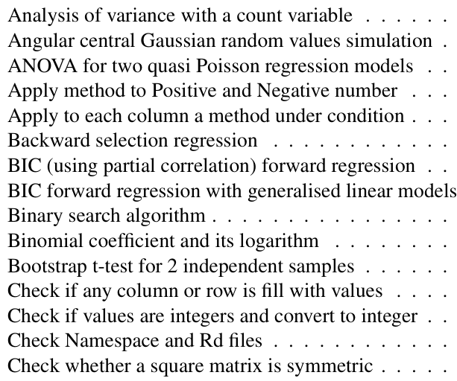
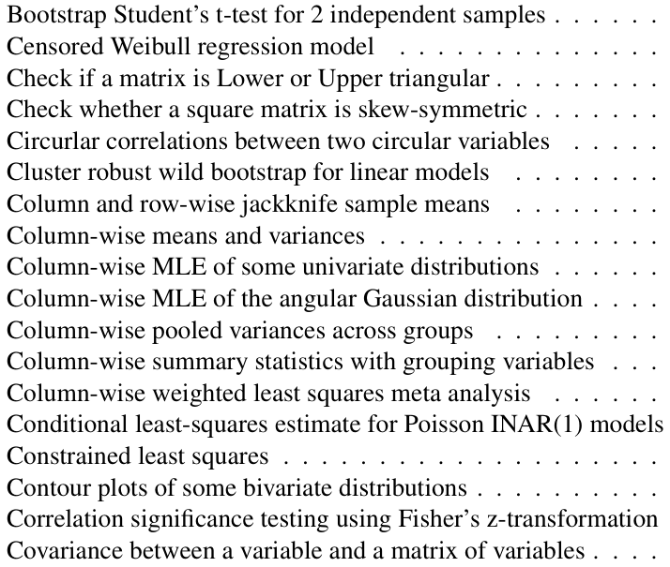
Rfast & Rfast2
Rfast, abridged.
Rfast2, abridged.

Slide 8
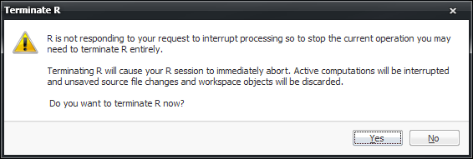
Remarks
C++ (and regular C) functions can be called from R
Lots of stock functions already do so!
Overhead is non-trivial, however…
C++ function calls (often) cannot be interrupted
Be prepared to kill your R process

Slide 9
Quick Examples

Slide 10
Quick Examples
> bench::mark(
+ as.matrix(iris),
+ data.frame.to_matrix(iris),
+ check = FALSE
+ )
# A tibble: 2 x 13
expression min median `itr/sec`
<bch:expr> <bch:t> <bch:t> <dbl>
1 as.matrix(iri~ 887.2us 930.5us 1014.
2 data.frame.to~ 11.8us 12.9us 73901.
Caveat 1:
Reduced scope of Rfast functions

Slide 11
Quick Examples
> bench::mark(
+ sample.int(1e6, 1e5),
+ Sample.int(1e6, 1e5),
+ check = FALSE
+ )
# A tibble: 2 x 13
expression min median `itr/sec`
<bch:expr> <bch> <bch:> <dbl>
1 sample.int(1e+06~ 7.8ms 8.41ms 108.
2 Sample.int(1e+06~ 5.3ms 5.83ms 163.
Caveat 2:
Extended features may be missing

Slide 12
Quick Examples
> bench::mark(
+ pmax(a, b),
+ Pmax(a, b)
+ )
# A tibble: 2 x 13
expression min median `itr/sec`
<bch:expr> <bch:tm> <bch:tm> <dbl>
1 pmax(a, b) 100.2ms 101.4ms 9.84
2 Pmax(a, b) 30.6ms 33.3ms 29.6
Caveat 3:
Regular features may be missing

Slide 13
Quick Examples
> set.seed(3)
> x = runif(1e6)
> bench::mark(
+ sort(x),
+ Sort(x)
+ )
# A tibble: 2 x 13
expression min median `itr/sec`
<bch:expr> <bch:tm> <bch:tm> <dbl>
1 sort(x) 93.5ms 95ms 10.5
2 Sort(x) 70.7ms 71.5ms 13.0
Caveat 4:
s and S kind of look the same

Slide 14
Quick Examples
> bench::mark(
+ matrix(rnorm(1e7), 1e5, 1e2),
+ matrnorm(1e5, 1e2),
+ rmvnorm(1e5, rep(0, 1e2), diag(1e2)),
+ check = FALSE
+ )
# A tibble: 3 x 13
expression min median `itr/sec`
<bch:expr> <bch> <bch:> <dbl>
1 matrix(rnorm(1e+~ 840ms 840ms 1.19
2 matrnorm(1e+05, ~ 129ms 129ms 7.78
3 rmvnorm(1e+05, r~ 341ms 345ms 2.90

Slide 15
Quick Examples
> X = matrnorm(1e5, 1e2, seed = 1)
> bench::mark(
+ rowSums(X),
+ rowsums(X)
+ )
# A tibble: 2 x 13
expression min median `itr/sec`
<bch:expr> <bch:tm> <bch:tm> <dbl>
1 rowSums(X) 25.19ms 26.7ms 37.4
2 rowsums(X) 8.96ms 10.4ms 93.8

Slide 16
Quick Examples
> bench::mark(
+ colMeans(X),
+ colmeans(X)
+ )
Error: Each result must equal the first result:
`colMeans(X)` does not equal `colmeans(X)`

Slide 17
Quick Examples
> unname(colMeans(X) - colmeans(X))
[1] -8.673617e-19 2.862294e-17
[3] 6.505213e-18 1.561251e-17
[5] -1.637145e-17 -3.469447e-18
[7] 1.387779e-17 -4.597017e-17
[9] 3.079134e-17 -1.301043e-18
[11] 6.678685e-17 1.192622e-17
[13] 1.279359e-17 -2.168404e-17
[15] 1.474515e-17 1.301043e-18
[17] -2.862294e-17 0.000000e+00
[19] -5.204170e-18 -1.994932e-17

Slide 18
Brief Aside
Floating point math!
In principle:
In practice: > 10^10 + 10^-10 - 10^10 [1] 0 > 10^10 + 10^-10 - 10^10 == 0 [1] TRUE > 10^10 - 10^10 + 10^-10 [1] 1e-10
https://0.30000000000000004.com/

Slide 19
Brief Aside
More confusingly: > M = as.matrix( + c(10^10, 10^-10, -10^10) + ) > base::colSums(M) [1] 0 > Rfast::colsums(M) [1] 1e-10
In practice: > 10^10 + 10^-10 - 10^10 [1] 0 > 10^10 + 10^-10 - 10^10 == 0 [1] TRUE > 10^10 - 10^10 + 10^-10 [1] 1e-10
https://0.30000000000000004.com/

Slide 20
Quick Examples
> bench::mark(
+ colMeans(X),
+ colmeans(X),
+ check = FALSE,
+ min_iterations = 5
+ )
# A tibble: 2 x 13
expression min median `itr/sec`
<bch:expr> <bch:tm> <bch:tm> <dbl>
1 colMeans(X) 8.75ms 8.94ms 103.
2 colmeans(X) 1.03s 1.25s 0.810

Slide 21
Quick Examples
n = 1e7
bench::mark(
sort(runif(n)),
Sort(runif(n)),
sort(dqrng::dqrunif(n)),
Sort(dqrng::dqrunif(n)),
head(prop.table(cumsum(rexp(n + 1))), -1),
head(prop.table(cumsum(dqrng::dqrexp(n + 1))), -1),
check = FALSE,
min_iterations = 5
)

Slide 22
Quick Examples
expression min median `itr/sec`
<bch:expr> <bch:tm> <bch:tm> <dbl>
1 sort(runif(~ 1.34s 1.36s 0.731
2 Sort(runif(~ 1.17s 1.19s 0.837
3 sort(dqrng:~ 1.04s 1.08s 0.917
4 Sort(dqrng:~ 874.97ms 879.17ms 1.14
5 head(prop.t~ 586.29ms 589.02ms 1.69
6 head(prop.t~ 252.47ms 254.97ms 3.85
Going from 1.35 to 0.87 is good…
Going to 0.25 is much better!

Slide 23
Takeaway
Sneaking in Rfast/Rfast2 replacements is usually easy
Skips a lot of sanity checks
Isn’t always appreciably faster… benchmark!
Not the only packages!
dqrng has some fast random number generators
Note that these packages may not inherit R’s RNG seed

Slide 24
Exploring Overhead

Slide 25
C++ Overhead
The call out to C++ isn’t free
Let’s revisit the world of benchmarking…

Slide 26
bench::press
sorted.uniform = bench::press(
n = c(3, 7, 11),
p = c(3, 5, 7),
rep = 1:5,
{
bench::mark(
matrix(rnorm(n * p), n, p),
matrnorm(n, p),
check = FALSE,
min_iterations = 5
)
}
)
bench::press
Benchmark multiple parameter configurations
Full-factorial experimental design

Slide 27
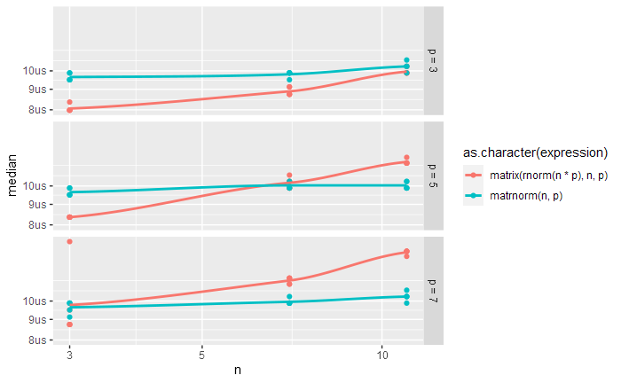
bench::press
bench::press
Benchmark multiple parameter configurations
Full-factorial experimental design

Slide 28

Hands-on practice!
Find a range of $n$ and $p$ that shows cross-over on your computer by trial-and-error

Slide 29
Mixture Model Example

Slide 30
Finite Gaussian Mixture Models & EM
Finite Gaussian Mixture Models

Slide 31
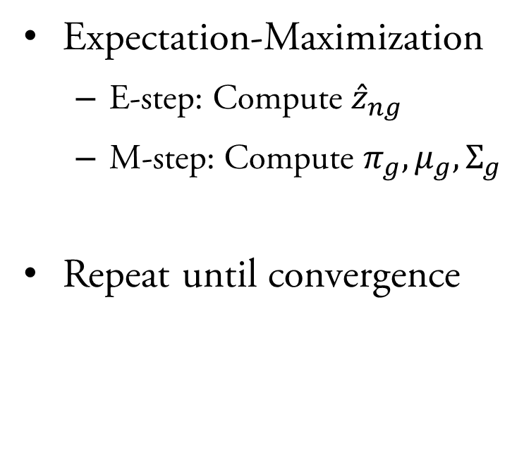
Finite Gaussian Mixture Models & EM
Expectation-Maximization
E-step: Compute ${\hat{z}}_{ng}$
M-step: Compute $π_{g},μ_{g},Σ_{g}$
Repeat until convergence

Slide 32
Finite Gaussian Mixture Models & EM
Hands-on practice!
Profile,
Modify,
Benchmark,
Repeat.

Slide 33
Rcpp Integration

Slide 34
Rcpp Package
Rcpp bridges R with C++
Write C++ functions to use in R
Auto-translates many common objects
Freedom to implement any functionality…
…except you need to write C++

Slide 35
Rcpp Package
Learning to write C++ code takes more than a day
Ready-made examples as a demonstration of…
How to use it
How effective it is
How surprisingly simple it sometimes is

Slide 36
Rcpp (and RcppArmadillo) Package
RcppArmadillo is a powerful linear algebra extension
We’ll revisit our finite Gaussian mixture example
Drop-in replacements for the helper functions provided
One-to-one correspondence
Same inputs, same outputs (numerically speaking)

Slide 37
Rcpp (and RcppArmadillo) Package
Hands-on practice!
Start small…
Suggested order!
Validate,
Benchmark,
Profile
Original Function | C++ Replacement
my.dmvnorm | dmvnorm_cpp
e.step | e_step_cpp
m.step | m_step_cpp
log.lik | log_lik_cpp
em.step | em_step_cpp

